Slide 1
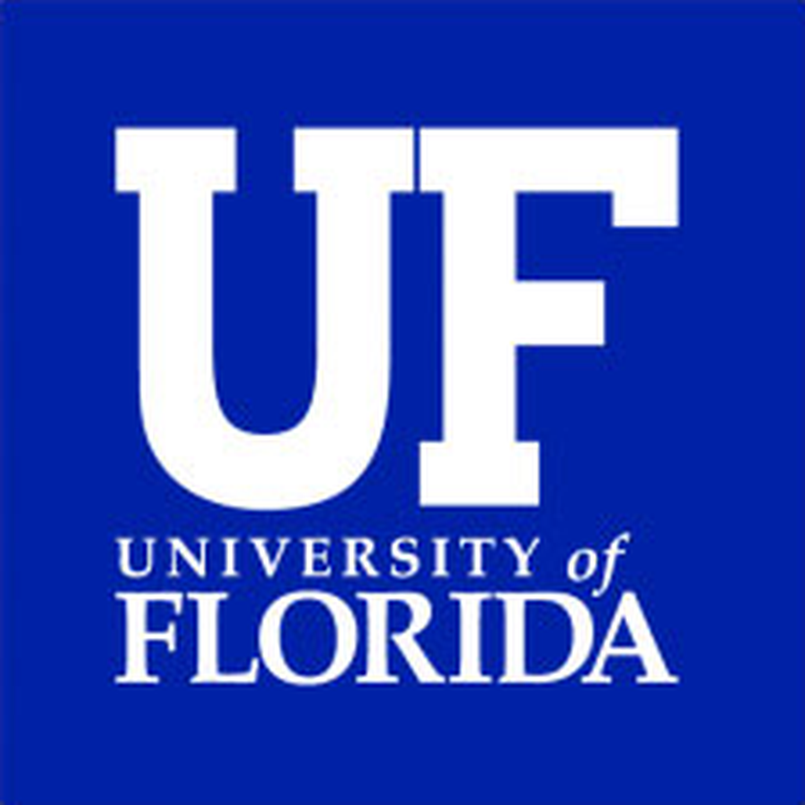
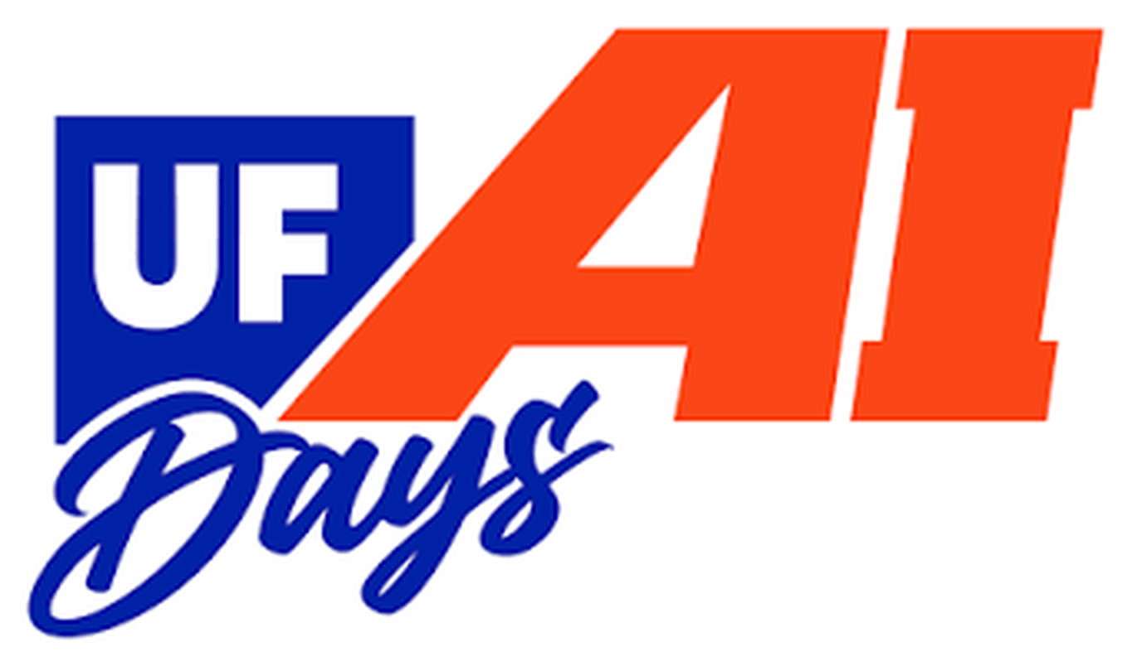
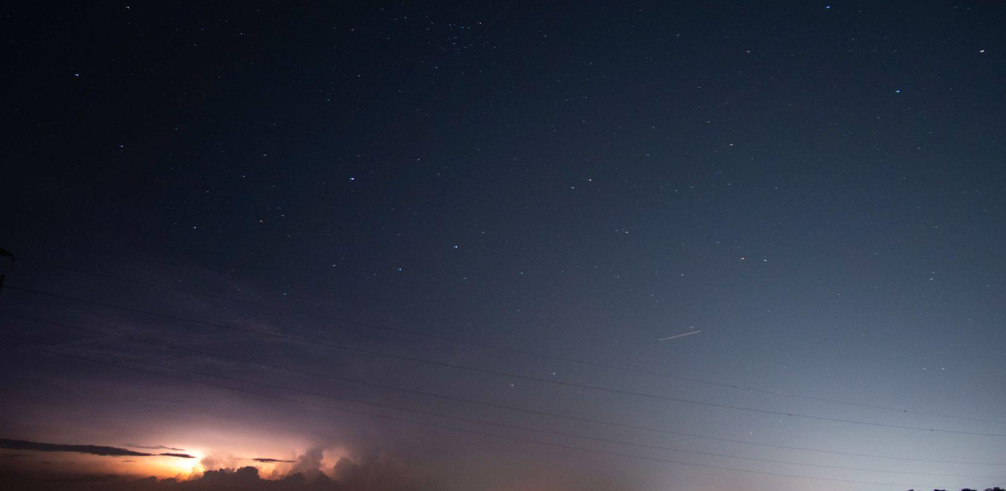
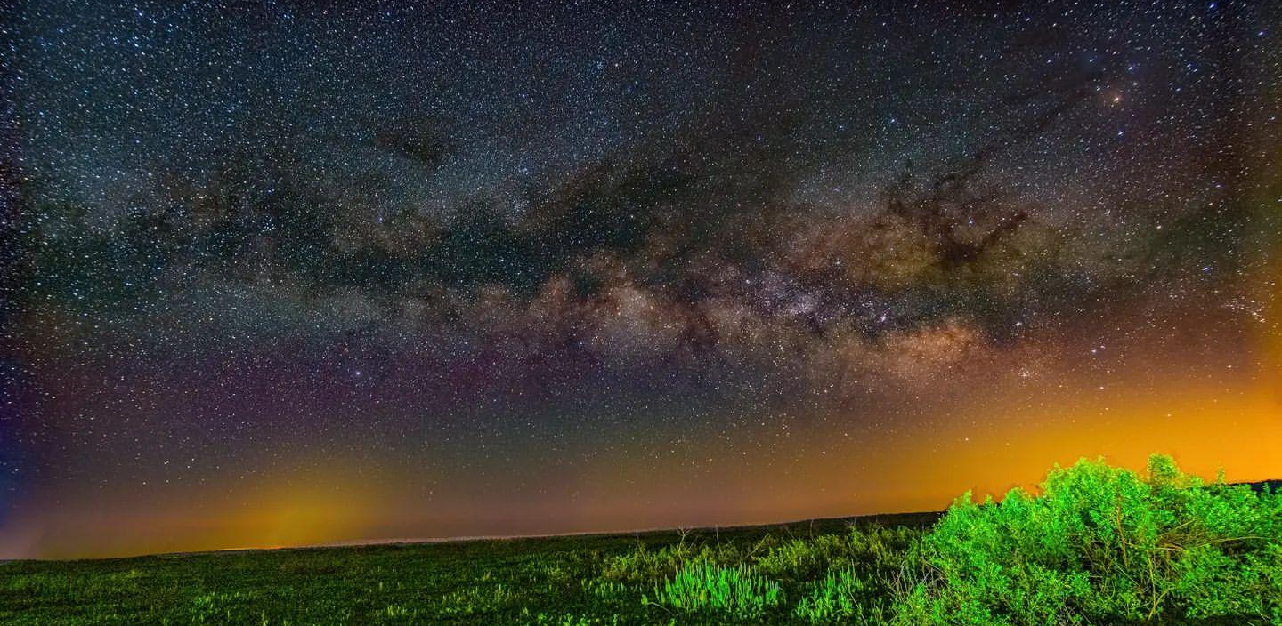
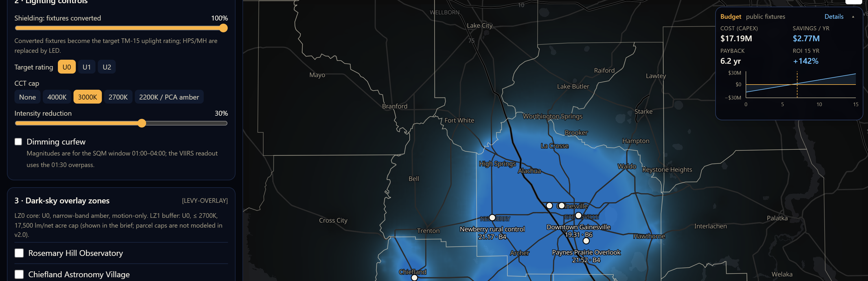
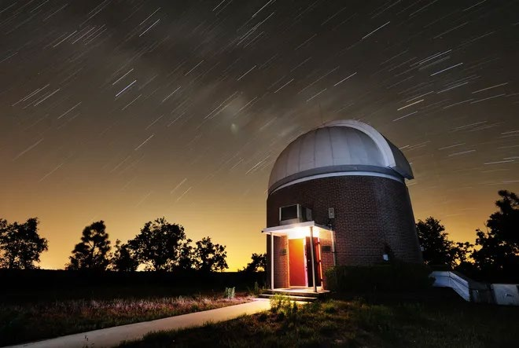
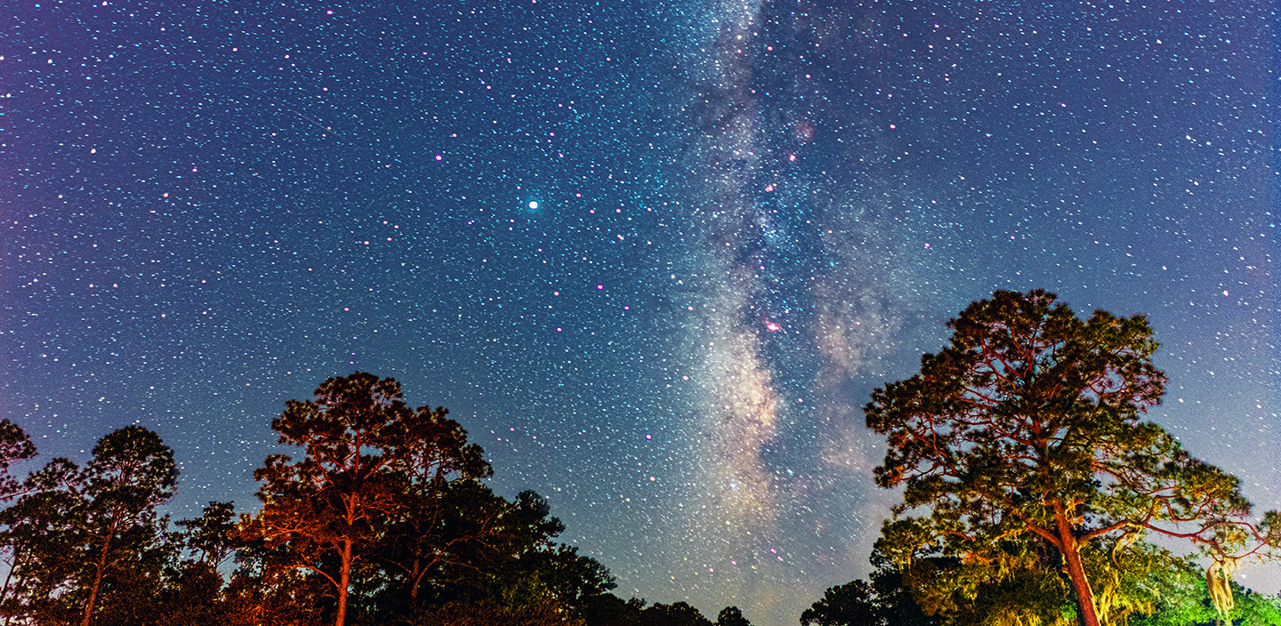
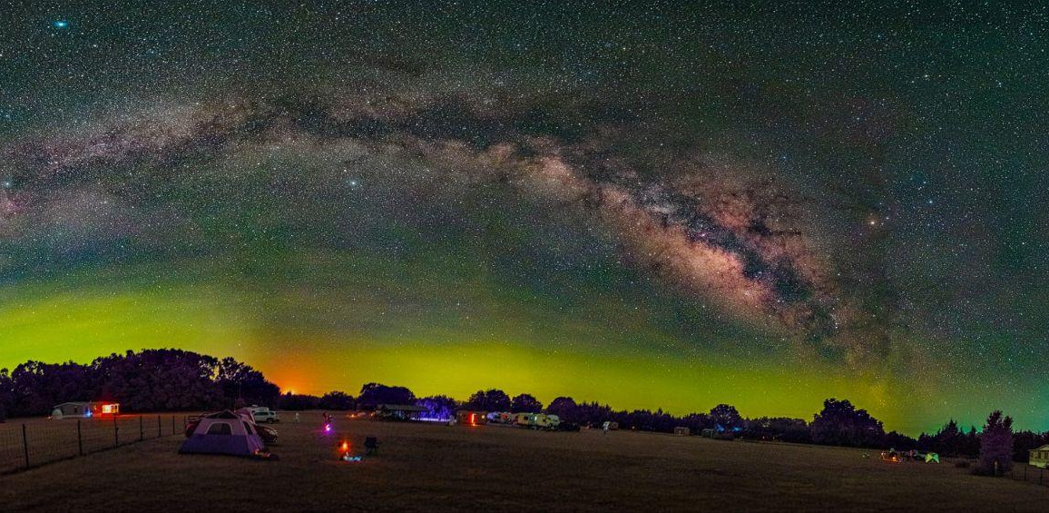
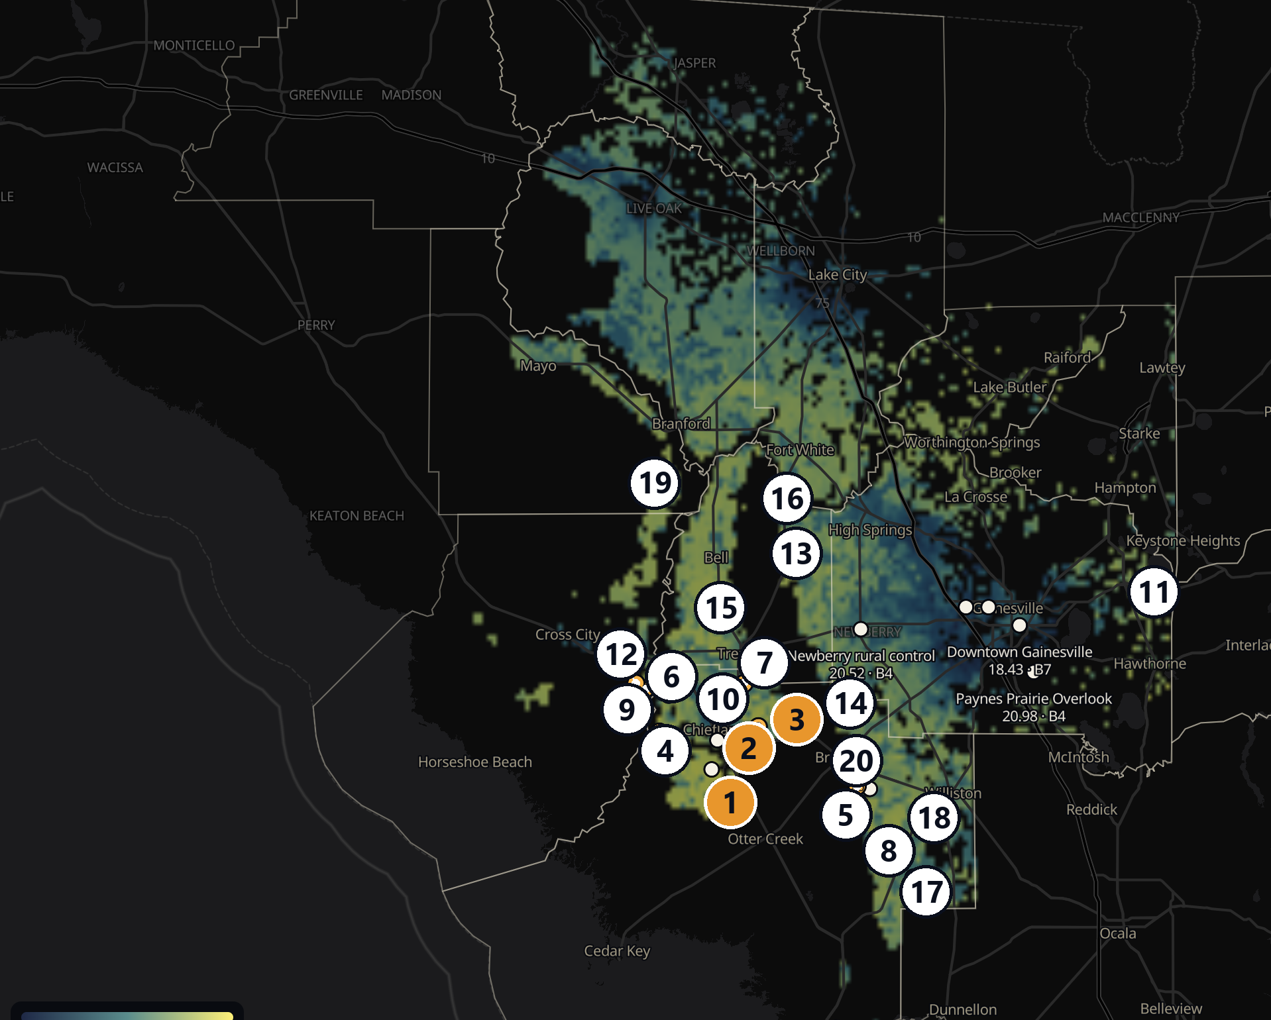
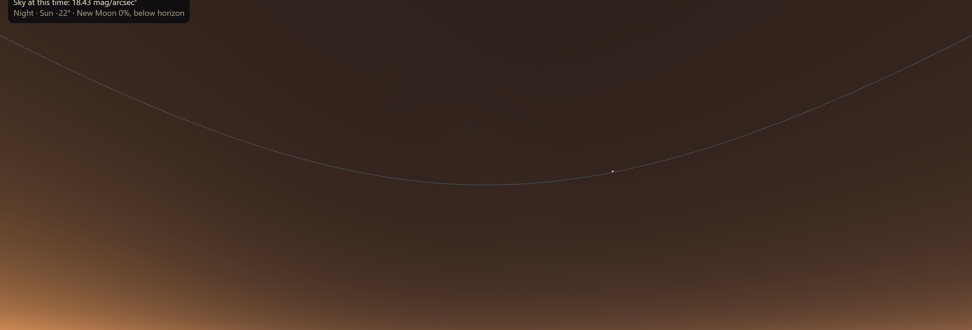
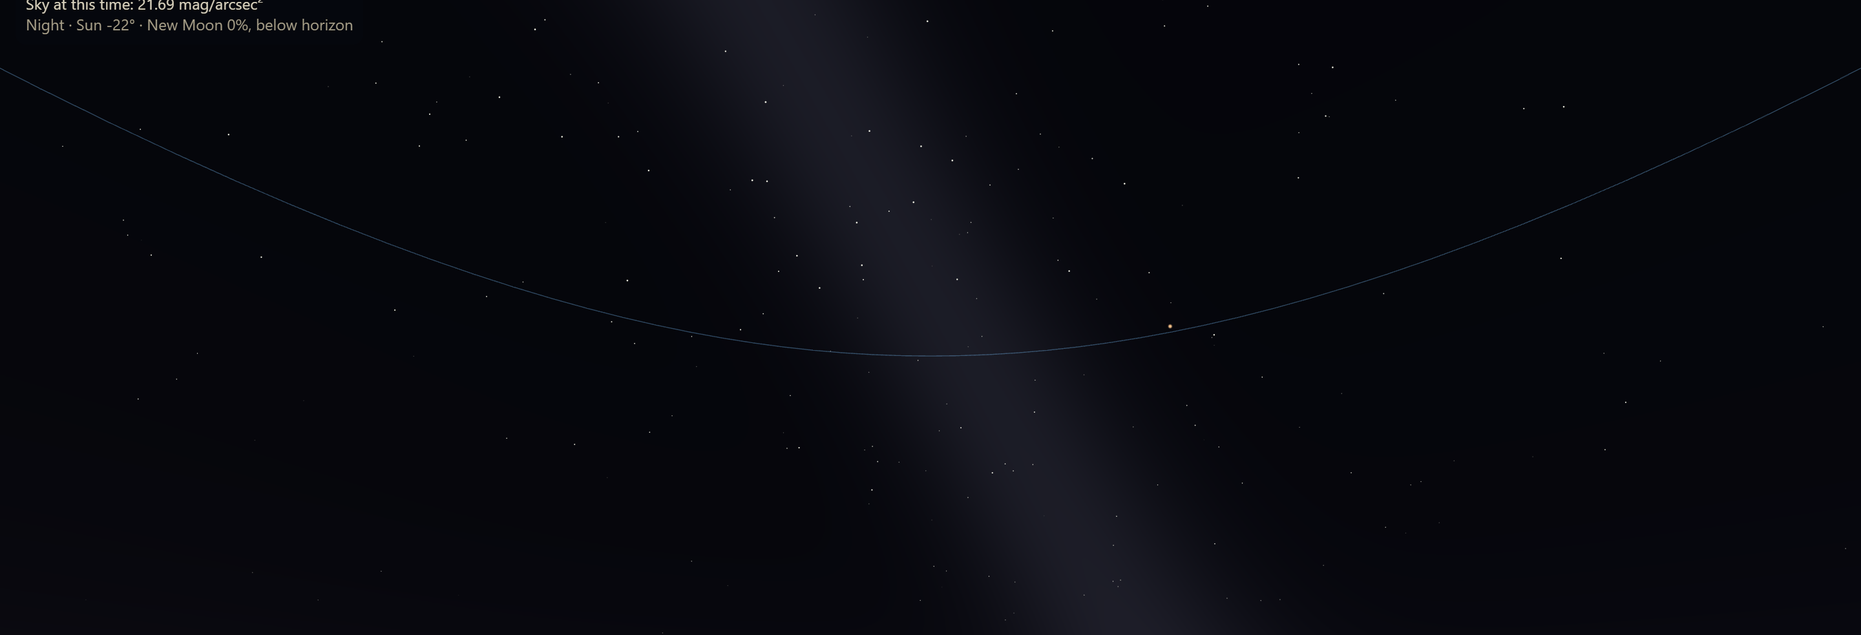
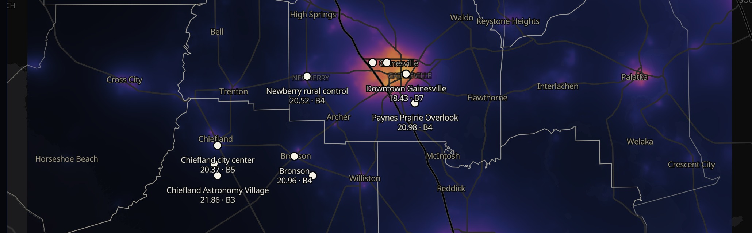
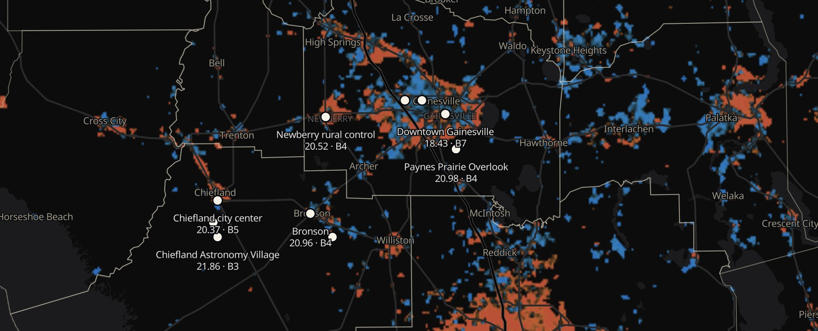
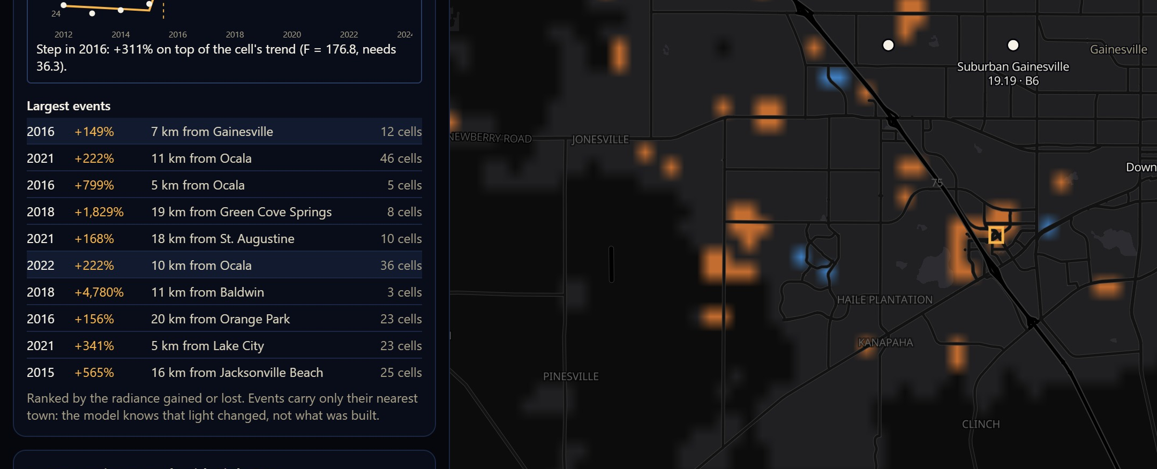
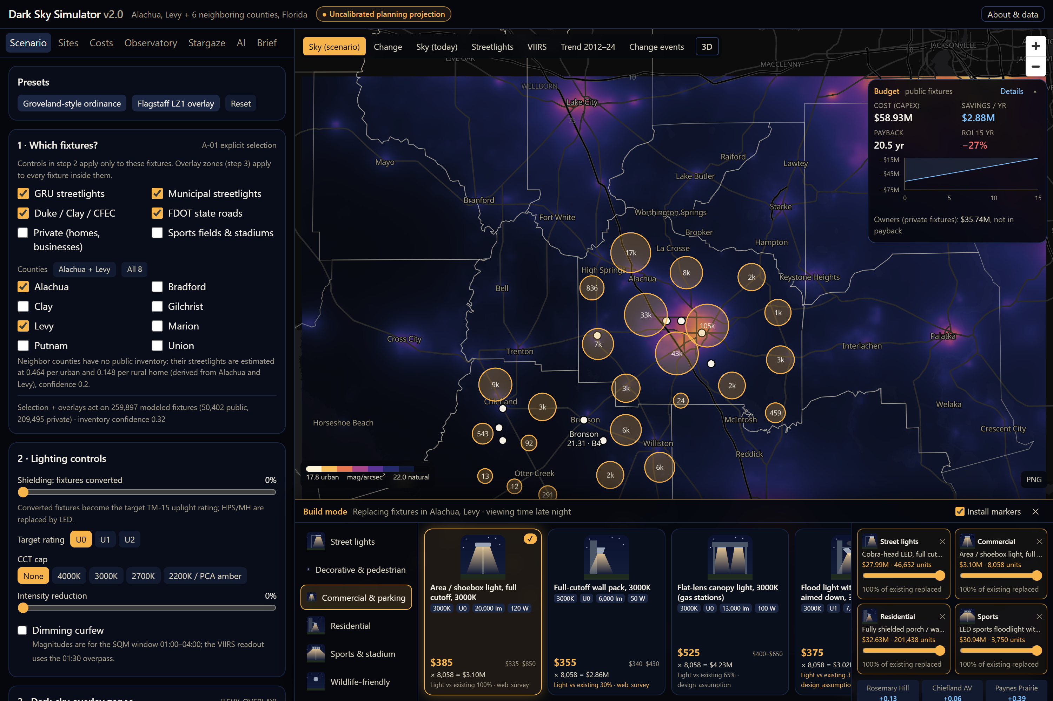
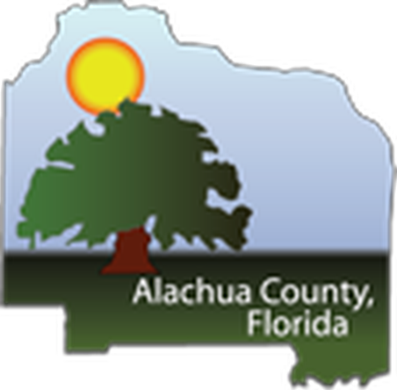
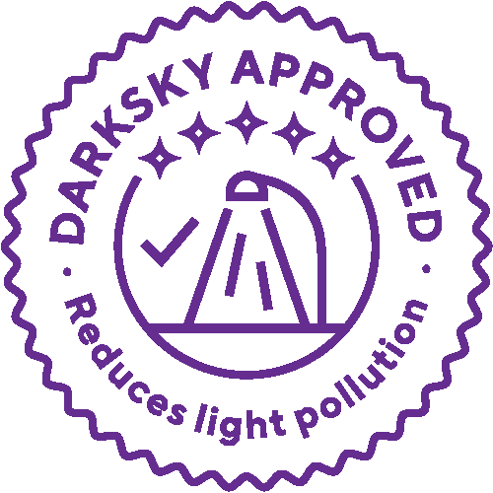
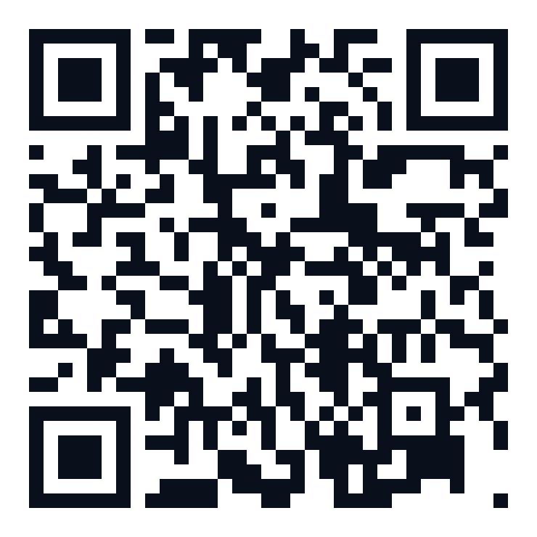
Restoring the Milky Way
Abstract
Artificial light at night is an expanding environmental and planning problem that affects astronomical observation, wildlife, energy consumption, and the visibility of the night sky. It is also highly preventable. Shielding fixtures, directing light where it is needed, using warmer color temperatures, reducing excessive brightness, and establishing dimming schedules can substantially reduce skyglow while preserving necessary nighttime illumination. Communities, however, often lack accessible tools for evaluating these changes before incorporating them into policy or development plans.
The Dark Sky Simulator is an interactive decision-support platform that makes lighting-policy choices visible and testable. Its initial Alachua County implementation combines AI-assisted analysis of NOAA nighttime satellite imagery with geospatial mapping and scenario modeling. Analysis of imagery from 2012 through 2024 identified an estimated 19 percent increase in countywide nighttime brightness. Users can simulate combinations of shielding, color-temperature limits, intensity reductions, and lighting curfews, then compare projected changes in sky brightness, Bortle Scale classifications, energy use, implementation costs, annual savings, and payback periods. These outputs are planning projections rather than observed outcomes.
This research helped inform amendments to the Alachua County Comprehensive Plan and is now expanding into Levy County. Levy County is home to both UF’s Rosemary Hill Observatory and the Chiefland Astronomy Village, a working dark-sky observing community increasingly vulnerable to surrounding development and skyglow. The expanded platform will establish a reusable process for incorporating county-specific satellite data, lighting conditions, development patterns, and policy scenarios, allowing communities to evaluate mitigation strategies without rebuilding the system for each jurisdiction.
A future application is astronomical site selection. At the request of Dr. Elizabeth Lada, Chair of the UF Department of Astronomy, the research will explore how the platform could help identify locations for a future UF observatory that are both sufficiently dark and less vulnerable to long-term development.
The presentation will demonstrate how AI-assisted environmental analysis and interactive simulation can support lighting policy, regional planning, observatory protection, and dark-sky conservation across North Central Florida.
Scaling AI-Assisted Light Pollution Planning Across North Central Florida
Plenary Talk · Tue., Oct. 27, 2026
2:40–2:55 PM · Reitz Union Grand Ballroom
AI Research, Teaching, and Learning Day
Jay Rosen
Research Software Engineer III · University of Florida College of Education · jayrosen@ufl.edu
1 A Growing, Preventable Problem
3 Projected Impact: A Darker Sky
6 Costs and Savings by Government
8 Levy County and Rosemary Hill
Simulator runs for Alachua and Levy: public lights right-sized (full shielding, a 3000 K cap as in Groveland's ordinance¹⁵, 30% lower output), the package priced in section 6, then private lights meeting the same standard. Sky brightness comes from a published scattering model.¹⁶
The platform is now expanding into Levy County, home to UF's Rosemary Hill Observatory and the Chiefland Astronomy Village, a working dark-sky observing community increasingly vulnerable to development and skyglow.
Bortle class¹ (brighter city sky ← → natural dark sky)
Figure 8. UF's Rosemary Hill Observatory, where skyglow from surrounding towns brightens the sky.¹² With no action, the 2034 forecast brightens it from 21.69 to 21.65 mag/arcsec²; right-sized public lights in Alachua and Levy hold it at 21.75, and 21.84 if private lights follow: Bortle 3. Dark-sky zones around Rosemary Hill and the Chiefland Astronomy Village alone: about $750K in public retrofits.⁶ Photo: The Gainesville Sun, April 2012.²⁶
8–9
7
6
5
4
3
2
1
Downtown Gainesville
37% / 56% darker
16% / 47% darker
Figure 5. Right-sized lights set in the simulator's controls (left): full shielding, 3000 K cap, 30% lower output, no curfew hardware. The map shows where the sky gets darker (blue); the budget card shows $17.19M, $2.77M saved a year, 6.2-year payback.
Chiefland city center
23% / 39% darker
Paynes Prairie
9% / 14% darker
$2.8M
saved every year,
Alachua + Levy
6.2 years
to pay back the
$17.2M one-time cost
$9.6M
saved every year if all
8 counties adopt
Figure 1. Top: Gainesville's skyglow with Comet NEOWISE (2020) and the Milky Way (2022), both from Paynes Prairie, Bortle 4.¹ Bottom: Stephen C. Foster State Park, GA, Bortle 2 (2020), and the Chiefland Astronomy Village, Bortle 3 (2025). Photos: Jay Rosen.
Rosemary Hill Obs.
3% / 6% darker
Chiefland Astr. Village
DarkSky Park level (21.2)¹⁷
Where Could UF Build Its Next Observatory?
Artificial light at night affects astronomy, wildlife, energy use and the view of the night sky,^{2,3} and it reaches UF's Rosemary Hill Observatory and the Chiefland Astronomy Village in Levy County. It is also preventable:⁴
today
public lights
+ private lights
Right-sized public lights save 14.6 million kWh a year in Alachua and Levy (about 1,360 homes)²²; savings are energy plus maintenance at each utility's rates:⁶
Requested by Dr. Elizabeth Lada, Chair of UF Astronomy: every ~1 km cell of 11 counties is scored for a dark sky today, little development by 2034, clear air, land, access and drive time from UF. Ruled out: water and wetland,²⁷ the coast, ground below 5 m (Idalia's 2023 surge reached 12 ft;²⁸ the Gulf may rise 14–18 in by 2050²⁹), 2080 flood projections,³⁰ FEMA's 100-year floodplain³¹ and drives over ~90 min:
Bortle classes move one step at most, and only in towns: downtown Gainesville 7 → 6 and Chiefland city center 5 → 4 once private lights follow. Rosemary Hill and the Chiefland Astronomy Village are already near a natural sky and stay Bortle 3: for them the gain is protection from growth.
Government (public lights) | Cost | kWh/yr saved | Saved/yr | Payback
Alachua County (43,517) | $15.3M | 13.5M | $2.55M | 6.0 yr
City of Gainesville, GRU (30,000) | $7.20M | 8.08M | $1.45M | 5.0 yr
Levy County (3,135) | $1.88M | 1.14M | $228K | 8.3 yr
University of Florida (4,100) | $984K | 1.10M | $198K | 5.0 yr
State roads, FDOT (1,500) | $900K | 544K | $113K | 8.0 yr
City of Chiefland (285) | $171K | 103K | $21.5K | 8.0 yr
Shield
fixtures
Aim light
where needed
Warmer
color
Less
brightness
Dim late
at night
37% darker
downtown Gainesville sky,
public lights alone
9 of 10
sites where public lights offset
the growth forecast to 2034
Bortle 5 → 4
Chiefland city center,
if private lights follow
# | County | Land³² | Drive
1 | Levy | $605K | 58 min
2 | Levy | $806K | 47 min
3 | Levy | $677K | 44 min
4 | Levy | public | 62 min
5 | Levy | $1.12M | 44 min
6 | Levy | public | 59 min
7 | Levy | $806K | 46 min
8 | Levy | $1.60M | 43 min
9 | Dixie | $883K | 61 min
10 | Levy | $837K | 49 min
11 | Alachua | $866K | 26 min
12 | Dixie | $872K | 62 min
13 | Gilchrist | $997K | 45 min
14 | Levy | public | 35 min
15 | Gilchrist | $1.23M | 48 min
16 | Gilchrist | $1.10M | 45 min
Communities rarely have a way to test these changes before they write them into policy.
2 The Dark Sky Simulator
Right-sized = fully shielded 3000 K LEDs at 30% fewer lumens, no smart controllers (motion-only lighting saves more but pays back in about 13 years). UF: 4,100 campus pole lights, about 60% already LED,²³ at GRU rates. Gainesville and FDOT are within Alachua's total, Chiefland within Levy's.
Figure 3. The same moonless night in the simulator's all-sky view: downtown Gainesville, Bortle 7 (left), and Rosemary Hill, Bortle 3, with the Milky Way (right). Illustrative.¹⁸
What UF Can Do
4 AI-Assisted Satellite Analysis
Alachua County is writing dark-sky lighting into its plan; UF answers to the State of Florida, not the county, so campus lighting is UF's own decision.
Lead on campus: upgrade UF's 4,100 pole lights for $984K and save $198K a year
Protect UF's skies: keep Rosemary Hill and the next observatory site dark
Measure the real sky: fund a $6,000 network of sky sensors to check the model
Figure 9. Observatory suitability map (yellow = most suitable) with the 20 best candidate sites numbered by rank (orange = shortlist; markers enlarged for print; blank areas are ruled out), and the ranked list: land price for 80 acres, approximate drive from campus, shortlist highlighted. Sites marked “public” are mostly state conservation land.
≈ 19%
brighter, 2012–2024: AI analysis
of NOAA night imagery¹²
1,493
sudden lighting changes
found (≈29 by chance)¹⁹
Figure 2. Modeled sky brightness today across the eight counties (yellow = bright urban sky, dark = near natural).
7 Build Mode: DarkSky-Compliant Fixtures
Shortlist: Levy #1, #2, #3 near Chiefland and Bronson (#1 beside the Chiefland Astronomy Village): Bortle 3, 9–16 m above sea level, 0–12% floodplain.
An interactive decision-support platform: pick shielding, color limits, dimming or curfews; see the projected sky, energy, cost and payback
Began in Alachua County (2025 prototype⁵); now Alachua, Levy and six neighbors, about 817,000 modeled light sources^{6–8}
AI reads 13 years of NOAA and NASA nighttime satellite imagery (2012–2024)^{9–11}
Runs in a browser or on a phone; every output is a planning projection
44–58 min
drive from campus
(25–34 miles)
$605K–806K
land for 80 acres
(recorded sales)³²
≈ $1.6–3.8M
total with telescope +
building ($1–3M)^{33–35}
Figure 4. Left: where nighttime radiance rose (orange) or fell (blue), 2012–2024. Right: the largest change event the AI found, Celebration Pointe near I-75, which stepped up in 2016 when Bass Pro Shops opened.²⁰ The ≈19% covers the region around Alachua County;¹⁴ calibrated radiance^{9,10} shows the region up ~20%, the county 3–6%.
All 20 sites: 26–70 min away, ≥ 5.8 m elevation, ≤ 16% wetland, ≤ 19% floodplain; a site visit decides.
9 References
Policy Impact
5 Tech Stack
1. Bortle, J. E. (2001). Introducing the Bortle dark-sky scale. Sky & Telescope, 101(2), 126–129.
2. Falchi, F., Cinzano, P., Duriscoe, D., et al. (2016). The new world atlas of artificial night sky brightness. Science Advances, 2(6), e1600377.
3. Kyba, C. C. M., Altıntaş, Y. Ö., Walker, C. E., & Newhouse, M. (2023). Citizen scientists report global rapid reductions in the visibility of stars from 2011 to 2022. Science, 379(6629), 265–268.
4. DarkSky International & Illuminating Engineering Society (2020). Five Principles for Responsible Outdoor Lighting. darksky.org.
5. Rosen, J. (2025). Dark Sky Simulator (v1) [software]. Zenodo. doi:10.5281/zenodo.17252185.
6. Dark Sky Simulator research reports (2025): Gainesville Dark Sky Lighting Assessment; Streetlight Retrofit Cost-Benefit Analysis (Levy); Smart Streetlight Cost-Benefit Analysis; Street Lighting Dimming Savings Calculation (Duke LS-1, Clay Schedule L, CFEC). Unpublished.
7. OpenStreetMap contributors (2026). Road, street-lamp and sports-venue data. openstreetmap.org (ODbL).
8. U.S. Census Bureau (2020). TIGER/Line boundaries and roads; 2020 Census housing-unit counts.
9. Román, M. O., Wang, Z., Sun, Q., et al. (2018). NASA's Black Marble nighttime lights product suite. Remote Sensing of Environment, 210, 113–143.
10. Elvidge, C. D., Zhizhin, M., Ghosh, T., Hsu, F.-C., & Taneja, J. (2021). Annual time series of global VIIRS nighttime lights derived from monthly averages: 2012 to 2019. Remote Sensing, 13(5), 922.
11. Gorelick, N., Hancher, M., Dixon, M., et al. (2017). Google Earth Engine: Planetary-scale geospatial analysis for everyone. Remote Sensing of Environment, 202, 18–27.
12. Rosen, J. (2026, January 13). Preserving natural skies in Alachua County: Light pollution mitigation and economic impact. Alachua County Environmental Protection Advisory Committee.
13. Alachua County (2026, February 13). Comprehensive Plan proposed evaluation and appraisal based amendments, Conservation and Open Space Element, Policy 5.3.7.
14. Rosen, J. (2026). Dark Sky Simulator v2 [software], incl. ADR 0013 (the 19% reconstruction). github.com/jayrosen-design/dark-sky-simulator-v2.
15. City of Groveland, Florida (2022). Ordinance 2022-26, outdoor lighting regulations.
16. Garstang, R. H. (1986). Model for artificial night-sky illumination. Publications of the Astronomical Society of the Pacific, 98, 364–375.
17. DarkSky International. International Dark Sky Places program guidelines (Dark Sky Park: sky ≥ 21.2 mag/arcsec²). darksky.org.
18. Krisciunas, K., & Schaefer, B. E. (1991). A model of the brightness of moonlight. Publications of the Astronomical Society of the Pacific, 103, 1033–1039.
19. Andrews, D. W. K. (1993). Tests for parameter instability and structural change with unknown change point. Econometrica, 61(4), 821–856.
20. EMJ Construction (2016, September 1). Two new Florida Bass Pro locations underway. emjcorp.com.
21. Ke, G., Meng, Q., Finley, T., et al. (2017). LightGBM: A highly efficient gradient boosting decision tree. Advances in Neural Information Processing Systems, 30, 3146–3154.
22. U.S. Energy Information Administration (2023). How much electricity does an American home use? FAQ (2022 average: 10,791 kWh per residential customer). eia.gov.
23. Roldán Hernández, C. (2023, January 17). Security enhancements make for a brighter, safer campus. UF News, University of Florida.
24. Dark Sky Simulator fixture catalog (2026): installed unit costs from the research reports and a retail price survey of DarkSky-compliant fixture types (September 26, 2026); DarkSky Approved luminaire search, darksky.org.
25. DarkSky International. DarkSky Approved program and seal. darksky.org/what-we-do/darksky-approved.
26. The Gainesville Sun (2012, April). Photograph of the University of Florida Rosemary Hill Observatory.
27. Dewitz, J. (2023). National Land Cover Database (NLCD) 2021 Products. U.S. Geological Survey data release. doi:10.5066/P9JZ7AO3.
28. Cangialosi, J. P., & Alaka, L. (2026). Tropical Cyclone Report: Hurricane Idalia (AL102023), 26–31 August 2023. National Hurricane Center (original report February 13, 2024).
29. Sweet, W. V., et al. (2022). Global and Regional Sea Level Rise Scenarios for the United States. NOAA Technical Report NOS 01. National Oceanic and Atmospheric Administration.
30. Ward, P. J., et al. (2020). Aqueduct Floods Methodology. Technical Note. World Resources Institute. Data: WRI Aqueduct Floods Hazard Maps V2 via Google Earth Engine.
31. Federal Emergency Management Agency (2026). National Flood Hazard Layer (NFHL): Special Flood Hazard Areas. hazards.fema.gov, accessed October 20, 2026.
32. Florida Department of Revenue (2025). Tax roll and qualified sales (parcels ≥ 5 acres), via the Florida Geographic Information Office statewide parcels.
33. York University (2019, August 16). Installation of new telescope expected to be largest at a Canadian university. YFile.
34. ABC7 Los Angeles (c. 2011). Domes put in place for CSUSB's observatory.
35. Florida Institute of Technology (2004, August 19). Funding secured for Florida Tech telescope. Florida Tech News.
Alachua County Comprehensive Plan · Conservation and Open Space Element
Figure 6. Build mode with four fixture types (street, parking-lot, porch, sports). Markers cluster where fixtures would be replaced; cards show color temperature, uplight rating, lumens, watts and cost.
The prototype's findings shaped Policy 5.3.7: outdoor lighting must conserve energy, avoid harm to wildlife and protect the night sky while providing for public safety, following DarkSky and IES principles (light only where and when needed, at the lowest level necessary, in warmer colors). The Environmental Protection Advisory Committee voted unanimously (Jan. 2026) and brought it to the Board of County Commissioners (Feb. 2026).^{12,13}
AI and machine learning
LightGBM²¹ · scikit-learn · Claude Code · Lovable
Satellite data
Google Earth Engine · NASA Black Marble · NLCD 2021 · WRI Aqueduct
17 fixture types in six categories follow DarkSky lighting principles: fully shielded, warm color, no more light than needed.⁴ Each card links to DarkSky International's DarkSky Approved program to choose certified products; installed costs run from $162 (porch light) to $8,250 (sports floodlight).^{6,24}
GIS and open data
USGS 3DEP · Census TIGER · OpenStreetMap · Florida DOR parcels · FNAI · FEMA NFHL · Globe at Night
Data pipeline
Python · NumPy · SciPy · Shapely
Web app
React · TypeScript · Vite · Tailwind CSS · MapLibre GL · Three.js · Recharts · Zustand · jsPDF · Open-Meteo
Figure 7. DarkSky Approved seal, DarkSky International.²⁵
Try the simulator¹⁴
Tests and hosting
pytest · Vitest · GitHub · Vercel
dark-sky-simulator-v2.vercel.app/dark-sky
Independent, unfunded citizen-science research. Begun at the request of Alachua County's Environmental Protection Advisory Committee and expanded at the request of the Chiefland Astronomy Village and UF's Department of Astronomy.
Not yet a University of Florida project: not funded or endorsed by UF, and the author's UF title is listed for identification only. The author serves on the Board of Directors of the Alachua Astronomy Club; views are the author's own.
Sky values are uncalibrated planning projections from public data (no sky-meter calibration yet); costs use the simulator's unit prices and each utility's tariff. Simulator build of October 20, 2026.
Notes:
Impact-first poster based on the submitted abstract, with numbered citations. Print at 48 x 36 in.

